Slide 1
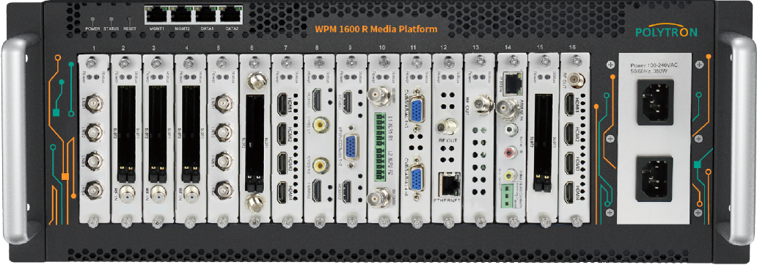
Polytron WPM 1600R Modular Digital /IP TV Head end
Polytron HDM-4 C
4x HDMI / ASI into DVB-C / ASI + IP modulator
The Polytron WPM 1600R is a strong modular TV/ video headend mountable on a 4U rack space suitable for DTV/ IPTV system for Residential complexes, Hotels, Offshore and Onshore Oil and Gas accommodations and Educational Institutions etc. This is a highly reliable product with dual power supply and with good signal to noise ratio and less power consumption, ideal for oil and gas accommodations due to the above features.
The modulator HDM-4 C converts four HDMI signals and ASI into one DVB-C (QAM) channel. The signal is also available as IP stream and can be fed into IPTV networks. The ASI signal is available for further processing at two outputs.
The video format can be either MPEG2 or MPEG4 standard. The device is wide range useable and can handle HDMI-signals from set-top-boxes, PC/notebooks, cameras, DVD players

Slide 2
Polytron HDM-4 Q
4x HDMI into DVB-C Encoder modulator
Polytron HDM-8 Q
8x HDMI into DVB-C Encoder modulator
The modulator HDM-4 Q converts four HDMI signals and into one DVB-C (QAM) channel. The video format can be either MPEG2 or MPEG4 standard. The device is wide range useable and can handle HDMI-signals from set-top-boxes, PC/notebooks, cameras, DVD players
The modulator HDM-8 Q converts four HDMI signals and into two DVB-C (QAM) channels. The video format can be either MPEG2 or MPEG4 standard. The device is wide range useable and can handle HDMI-signals from set-top-boxes, PC/notebooks, cameras, DVD players

Slide 3
Polytron HDM-4 I
4x HDMI into IPTV Encoder
Polytron HDM-8 I
8x HDMI into IPTV Encoder
The modulator HDM-4 I converts four HDMI signals and into 4 IPTV SPTS channels. The video format can be either MPEG2 or MPEG4 standard. The device is wide range useable and can handle HDMI-signals from set-top-boxes, PC/notebooks, cameras, DVD players
The modulator HDM-8 I converts four HDMI signals and into 8 IPTV channels. The video format can be either MPEG2 or MPEG4 standard. The device is wide range useable and can handle HDMI-signals from set-top-boxes, PC/notebooks, cameras, DVD players

Slide 4
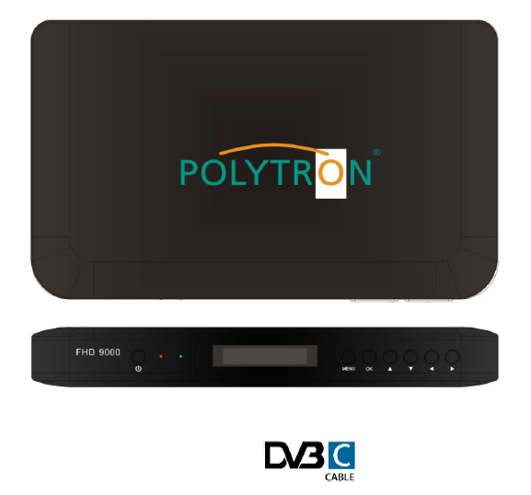
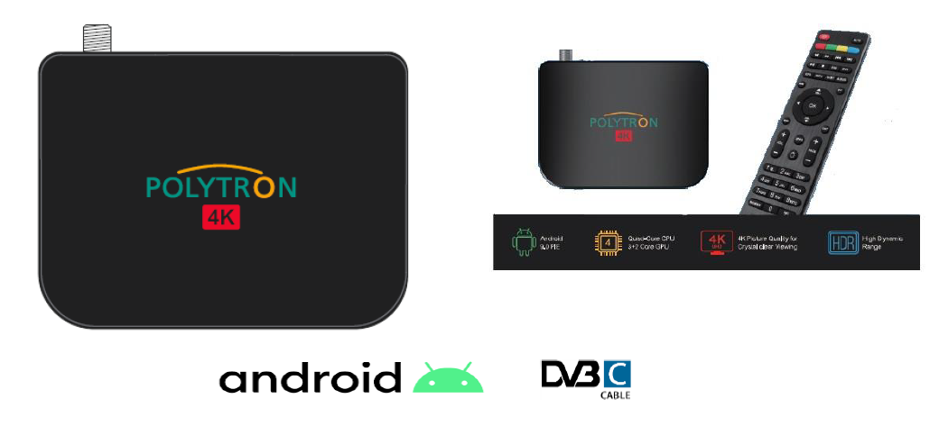
Polytron AHD-9000 Android DVB-C Hybrid STB
Polytron FHD-9000 DVB-C STB
AHD-9000 is a 4K Android TV Hybrid Set-top Box powered by Android. Fully compliant with DVB-C, Netflix, Amazone Prime, Youtube etc..
FHD-9000 is a DVB-C Set-top Box from Polytron which is highly reliable and powered with NIT and LCN features.
Polytron AHD-9000IP IPTV STB
Polytron IPTV Set Top Box is a compact device that combines a set-top box, media
center. You can use it for accessing IPTV services or Internet resources, as well as
viewing images, playing video and audio from various sources. Designed to use with Polytron IPTV Solution

